Slide 1
The Fate of the Housing Loan
A hack presented by:
Shivangi Gupta
Kaveesha Shah
Monica Kanasani
Manvitha Vajrala

Slide 2
Problem Statement
Analyze and visualize data to study the effect of various risk factors involved in predicting the status of the loan.
Develop a classification model to predict the category of loan status.

Slide 3
Data and Tech Stack
Data sourced from :
https://loanperformancedata.fanniemae.com/lppub/index.html#Portfolio
2 tables:
Acquisition: Fannie Mae acquisitions between January 1, 2000 and March 31, 2012
Performance: corresponding monthly performance data as of December 31, 2012.

Slide 4
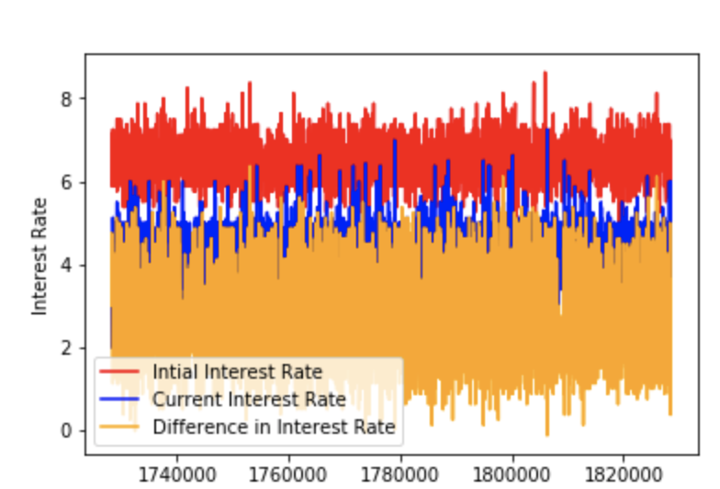
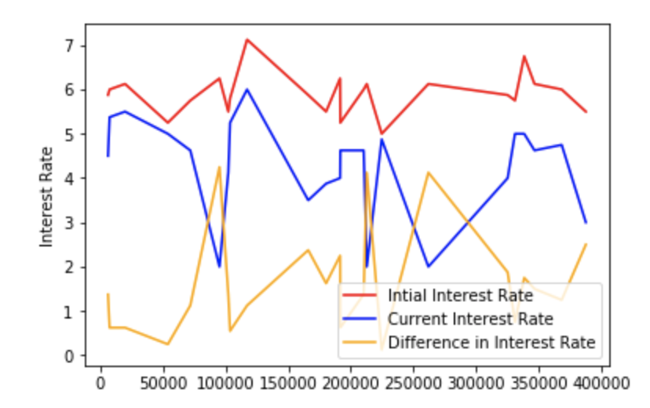
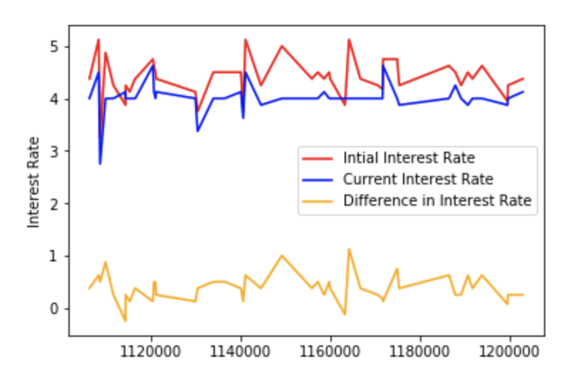
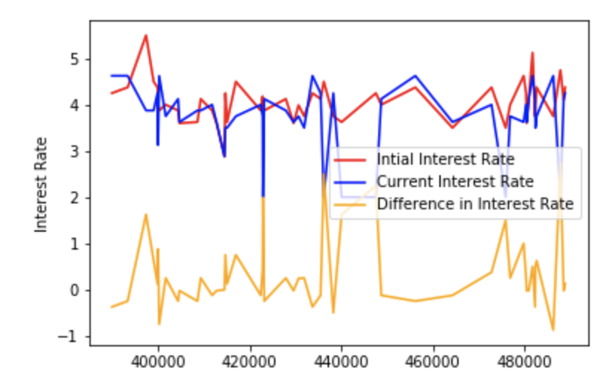
Interest rate analysis for 4 years
2003
2008
2012
2016

Slide 5
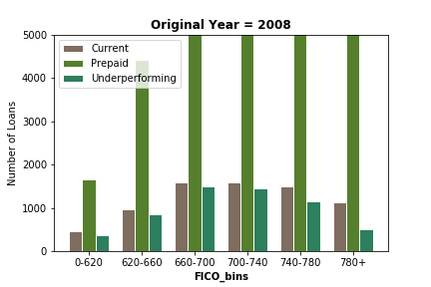
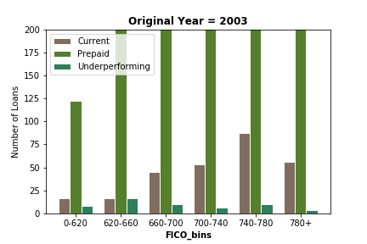
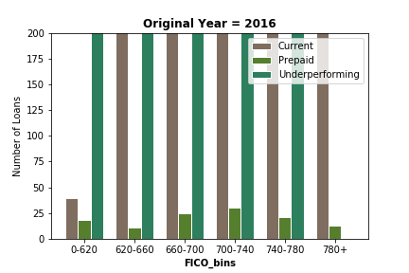
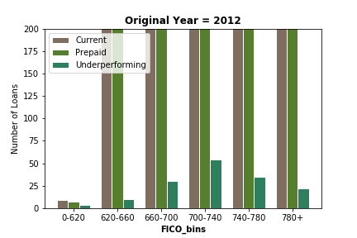
Bar graph for credit score vs loan status for 4 years.

Slide 6
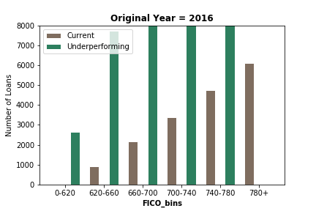
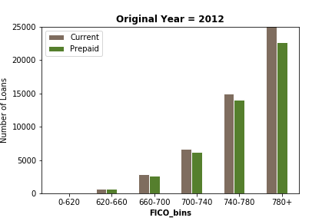

Slide 7
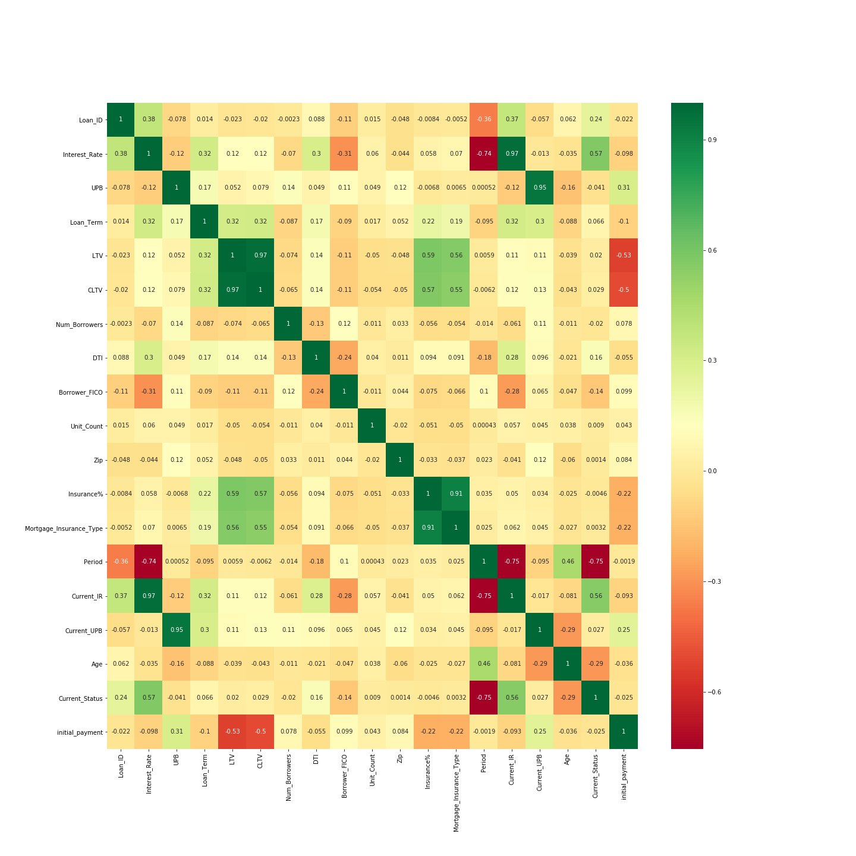
Correlation matrix

Slide 8
Feature used for model
Interest_Rate
UPB
Loan_Term
LTV
Num_Borrowers
Borrower_FICO
DTI
Insurance%
Period
Current_Status
Current_UPB

Slide 9
Model Creation
Experimented with 3 classification models:
Random Forest
Accuracy for Random Forest on testdata: 98.83%
XgBoost
Accuracy for XgBoost on test data: 99%
Logistic Regression

